Slide 1
E6156 – Topics in SW Engineering: Cloud Computing
Lecture 2: S3, REST, PaaS
© Donald F. Ferguson, 2022

Slide 2
We will start in a minute or two.

Slide 3

Contents
3 | E6156 – Topics in SW Engineering: Cloud Computing: Lecture 2 – REST, PaaS, S3 © Donald F. Ferguson, 2022

Slide 4
Contents
Cover VM Stuff from Lecture 1
BLOB, Bucket, S3:
Full-stack web application reminder and S3 motivation
Concepts
AWS Simple Storage Service (S3)
Web content/web serving
REST
Concepts
API definition and Open API
Some Examples
Platform-as-a-Service
Comparison to VMs and Infrastructure-as-a-Service
Elastic Beanstalk
Sprint 1.

Slide 5
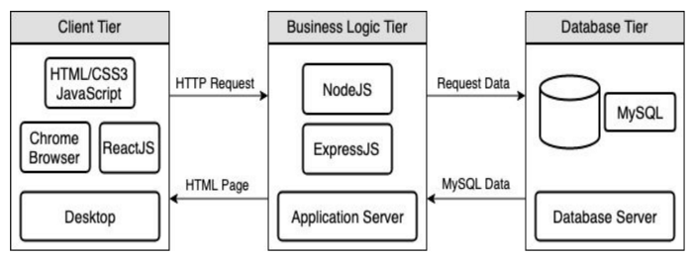
Full Stack Web Application – Reminder
https://levelup.gitconnected.com/a-complete-guide-build-a-scalable-3-tier-architecture-with-mern-stack-es6-ca129d7df805
My preferences are to replace
React with Angular
Node with Flask.
But the concept applies to all technology.
There are two choices for delivering the browser application
From a runtime, e.g. nginx, Flask, Apache, ...
S3
There is one project composed of three applications, each in its own repository..
Browser UI application.
Microservice.
Database.
We need to to design, develop, test, deploy, ... ... the individual applications and the project as a whole
We will initial have two deployments: local machine, virtual machine/S3/RDS.

Slide 6
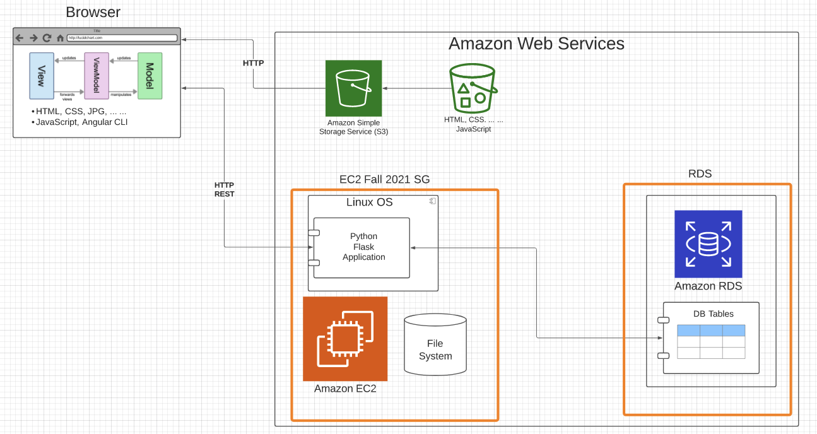
Sample Application Structure
Browser Application:
Content: HTML, CSS, ... ...
MVVM with Angular CLI
Static Content:
S3 Bucket
Web site hosting
Server: Amazon EC2 instance (IaaS)
Linux
Web Application Server
Flask
Python
Database: Amazon RDS (DBaaS)
Simple tables
MySQL Database Server
Lifecycle:
Develop and demo locally
Deploy and configure onto AWS
Will work on CI/CD later.
Two security groups:
One for EC2 instance
One for RDS
Slightly more secure than 1 SG.
Will cover security later.

Slide 7
VMs and EC2
7 | E6156 – Topics in SW Engineering: Cloud Computing: Lecture 2 – REST, PaaS, S3 © Donald F. Ferguson, 2022

Slide 8
Virtualization, Virtual Machines
"In computing, a virtual machine (VM) is an emulation of a computer system. Virtual machines are based on computer architectures and provide functionality of a physical computer. Their implementations may involve specialized hardware, software, or a combination." (https://en.wikipedia.org/wiki/Virtual_machine)
On mac laptop, I have:
One host operating system and HW (Mac, MacOS)
Two hypervisors (Virtual Box, VMWare Fusion)
Two guest OS: Windows 10, Debian Linux

Slide 9
Virtual Machines on Physical Machines

Slide 10
Virtual Private Cloud
“A virtual private cloud (VPC) is an on-demand configurable pool of shared resources allocated within a public cloud environment, providing a certain level of isolation between the different organizations (denoted as users hereafter) using the resources. ... ...
The isolation between one VPC user and all other users of the same cloud (other VPC users as well as other public cloud users) is achieved normally through allocation of a private IP subnet and a virtual communication construct (such as a VLAN or a set of encrypted communication channels) per user.” (https://en.wikipedia.org/wiki/Virtual_private_cloud)
A virtual machine on my laptop has a virtual adaptor connected to a real network.
A virtual private cloud is a set of virtual machines connected to a virtual network.
All cloud providers support virtual private clouds with the same concepts, but with slightly different realizations and terms.

Slide 11
Some Terminology (AWS)
There are several online tutorials. Understanding some terms is useful.
AWS has the concept of a Region, which is a physical location around the world where we cluster data centers. We call each group of logical data centers an Availability Zone. Each AWS Region consists of multiple, isolated, and physically separate AZ's within a geographic area.
An Availability Zone (AZ) is one or more discrete data centers with redundant power, networking, and connectivity in an AWS Region. AZs give customers the ability to operate production applications and databases that are more highly available, fault tolerant, and scalable than would be possible from a single data center.
A VPC is a virtual private cloud, which works like a private network to isolate the resources within it.
A route table contains a set of rules, called routes, that are used to determine where network traffic is directed.
A subnet is a defined set of network IP addresses that are used to increase the security and efficiency of network communications. You can think of them like postal codes, used for routing packages from one location to another.
A network interface represents a virtual network card. The network interface displays its network interface ID, subnet ID, VPC ID, security group, and the Availability Zone that it exists in.
A security group is a set of rules that controls the network access to the resources it is associated with. Access is permitted only to and from the components defined in the security group's inbound and outbound rules.
An internet gateway is a VPC component that allows communication between instances in your VPC and the internet.
A VPC endpoint enables you to privately connect your VPC to supported AWS services without using public IP addresses.
All clouds have similar concepts but with different names.

Slide 12
First Microservice
There are four distinct phases. The workflow becomes more sophisticated later:
Develop and test SW: In this example:
Develop and unit test:
Database
Data service
Application “resource,” which will be foundation for REST
Develop and test SW system by assembling components and application application container to form microservice.
Define and configure Infrastructure-as-a-Service:
Virtual machine (server, storage, networking).
Install and test supporting infrastructure SW.
Deploy and configure microservice, and test on IaaS.

Slide 13
Let’s Build our First VPC
Well, actually, let’s not do that for now.
We are just going to create our first virtual machine.
But,
The virtual machine is in my “default” VPC.
Setting up and using the VM requires understanding some of the concepts.
We can mostly just use the EC2 wizard for now.
I am going to set up a VM to host our first cloud application
I will deploy the application and supporting SW.
Basic tasks:
Configure and deploy VM, SSH credentials, security group rules.
Install supporting software: Python, MySQL.
Set up the database and deploy the application.
Run “Hello World” test.
But first, let’s walk through the application structure and implementation.
I am going to use RDS instead.

Slide 14
BLOBs, AWS S3, Web Server
14 | E6156 – Topics in SW Engineering: Cloud Computing: Lecture 2 – Microservices, REST, Containers, PaaS, S3 © Donald F. Ferguson, 2021

Slide 15
BLOB: Binary Large Object
Definitions:
“A binary large object (BLOB or blob) is a collection of binary data stored as a single entity. Blobs are typically images, audio or other multimedia objects, though sometimes binary executable code is stored as a blob. They can exist as persistent values inside some databases or version control system, or exist at runtime as program variables in some programming languages.” (https://en.wikipedia.org/wiki/Binary_large_object)
“Blob is the data type in MySQL that helps us store the object in the binary format. It is most typically used to store the files, images, etc media files for security reasons or some other purpose in MySQL.” (https://www.educba.com/mysql-blob/)
Intent:
File systems are not good for many application scenarios, which is why database management systems emerged.
Database management systems implement structured (or semi-structured) data, e.g. tables.
Database BLOBs were a way to have some “big things” as table or document properties.

Slide 16
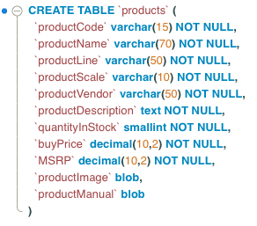
Simple Example
Structured or semi-structured information about an entity.
Queryable
Editable on forms
etc.
A file-like, opaque property associated with the entity.
URLs have primarily replaced BLOBs.
Show E6156 db_blob example.

Slide 17
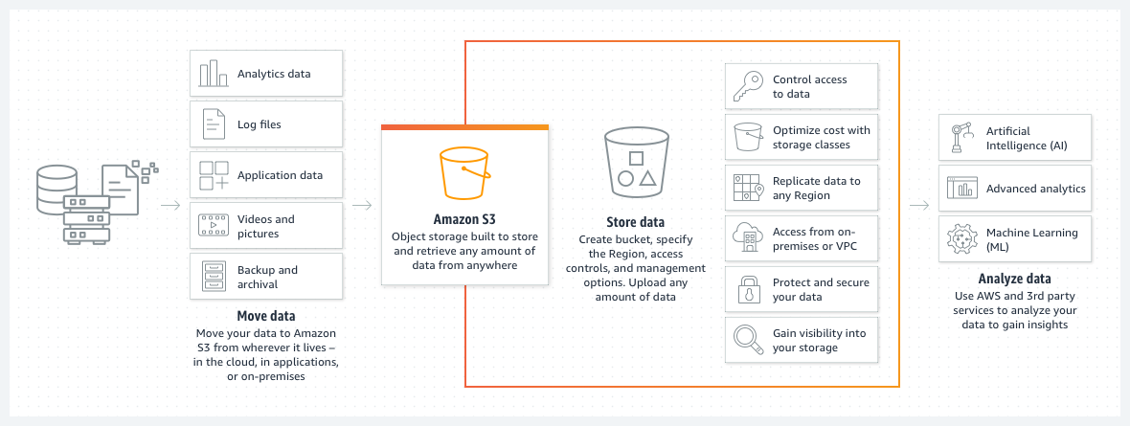
Amazon S3
We used the equivalent capability on Azure for uploading CAD files, storing processed files and results, etc.

Slide 18
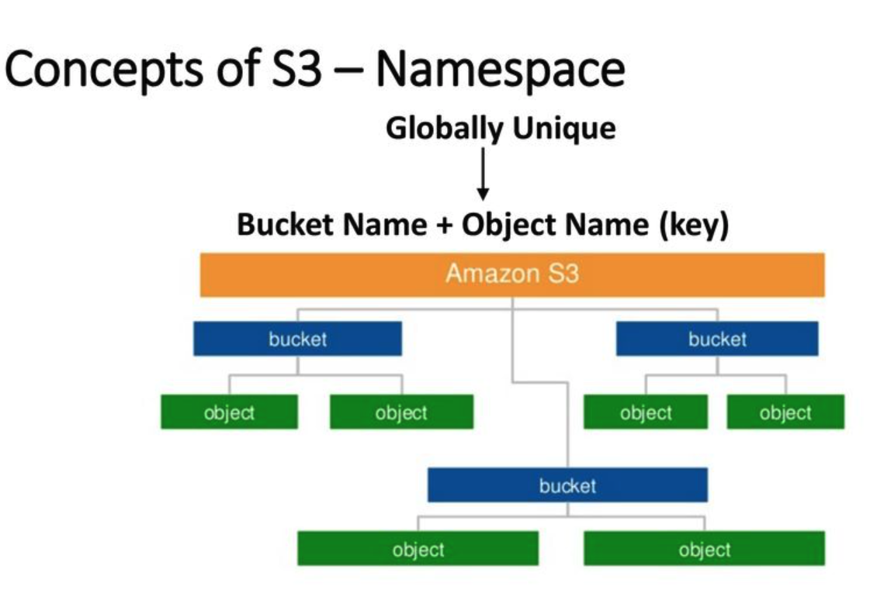
AWS S3
Can support a logical hierarchy with a convention on keys.
x/y
x/z
x/y/z
... ...
Acts kind of file system like, but is really just key strings.

Slide 19
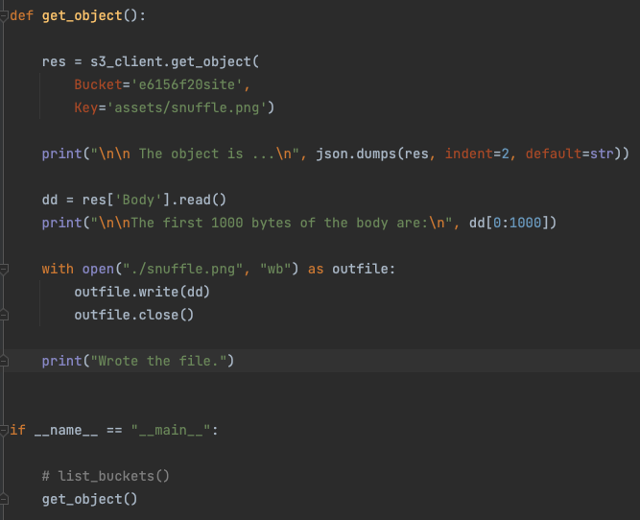
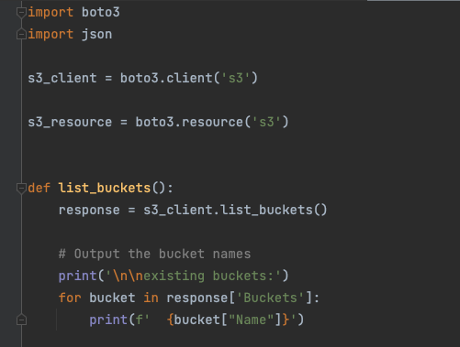
Simple S3 Example
/Users/donaldferguson/Dropbox/00NewProjects/e6156examples/s3/s3_examples.py

Slide 20
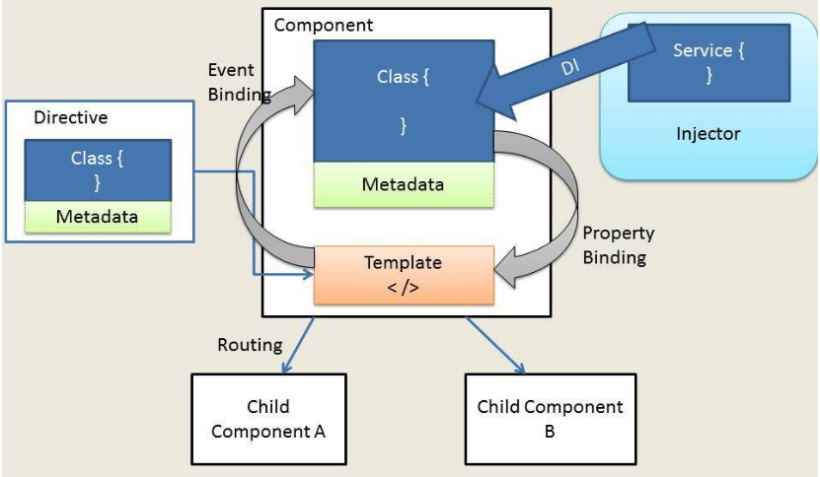
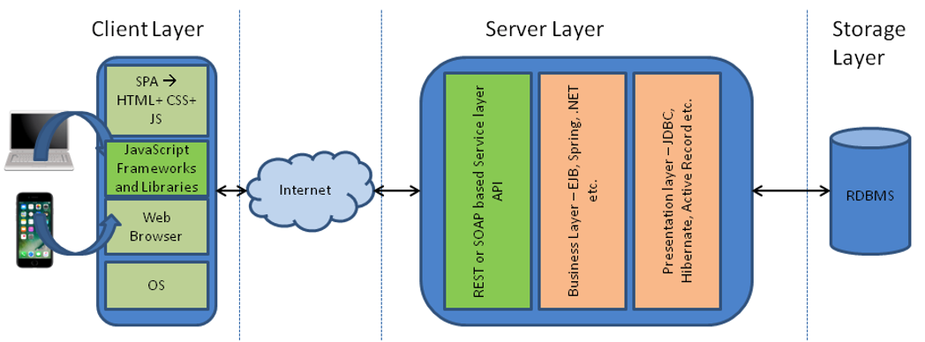
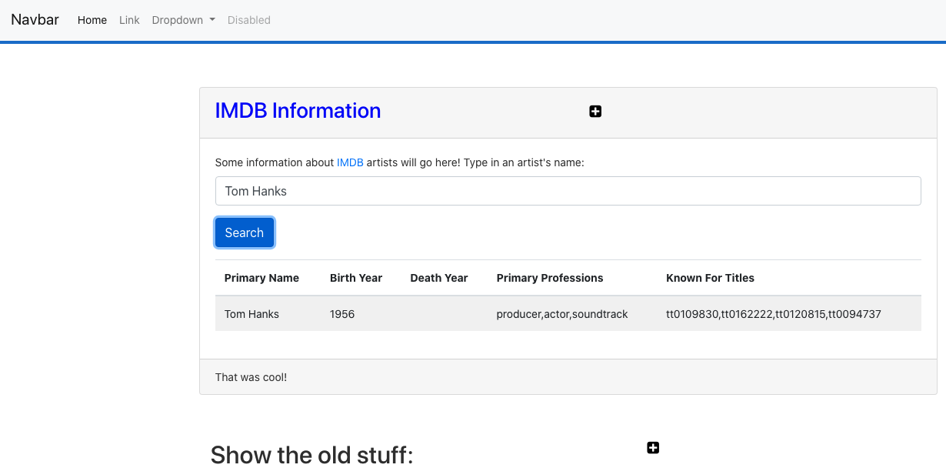
Web Application Architecture
https://dzone.com/articles/architectural-shift-in-web-applications-with-emerg
app.component
navbar.component
imdbartist.component
Template (HTML)
CSS
Component implementation
Service
Show the Code

Slide 21
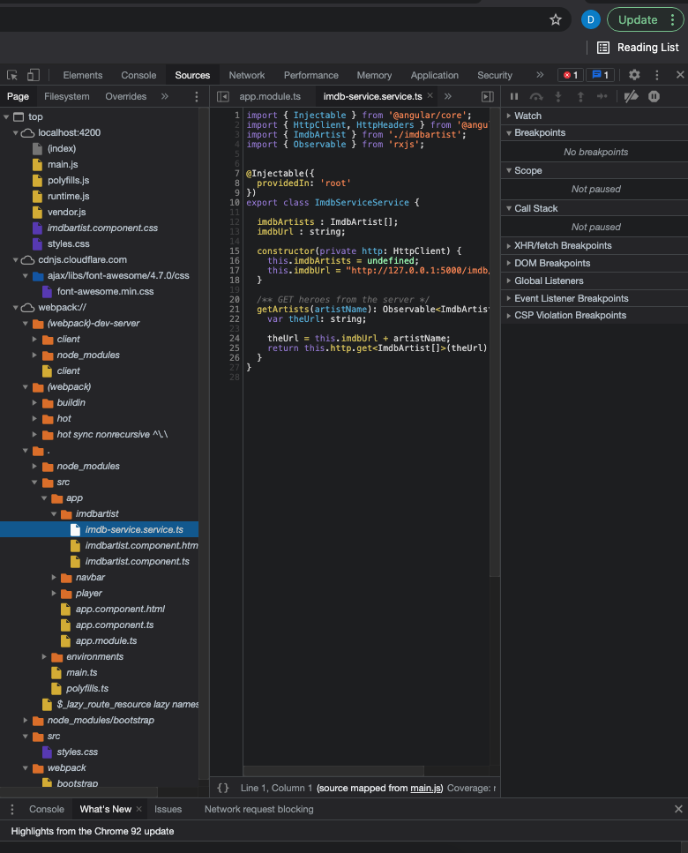
What’s in the Browser
The browser is an application that interprets the files:
HTML, CSS, etc. define the document and content.
JavaScript defines dynamic behavior.
Browser loads index.html
index.html contains links to files.
The browser loads the linked files.
These also have links, which the browser loads.
etc.
How did all of this get in the browser?
A web server delivers these files from “the file system.”
During development, Angular uses a simple, embedded web server.
“build” compiles the files into a webpack (see dist folder)
Deploying the application to the cloud →
We have seen deploying the application logic to the cloud.
What about the content?
Notes:
Show loading the demo-ui.
Show loading cnn.com.

Slide 22
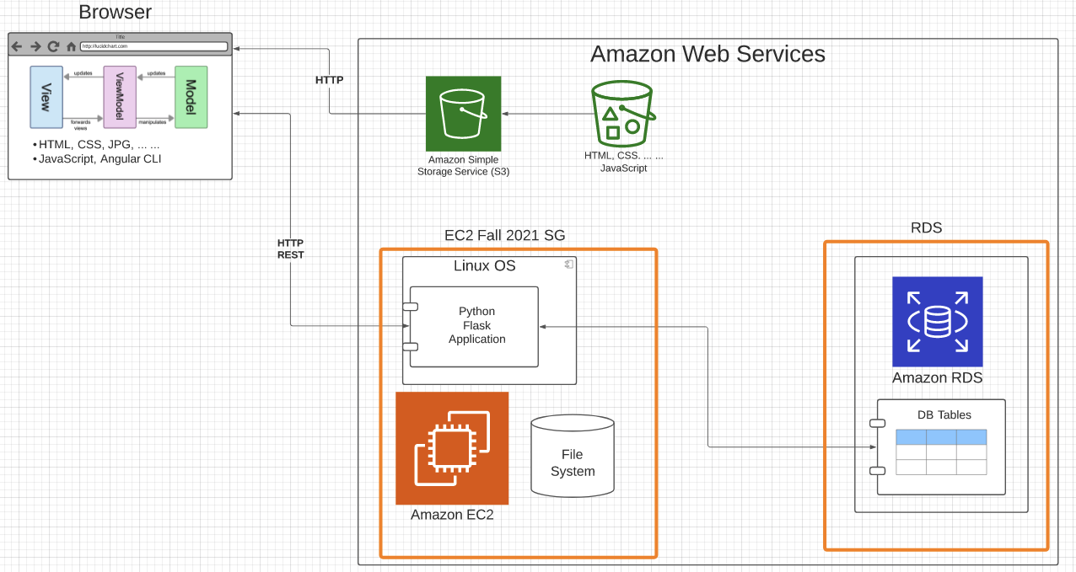
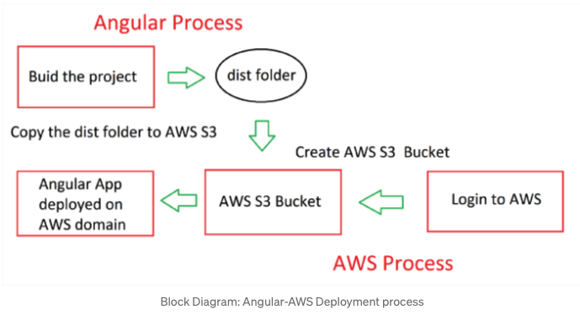
Deploy to S3
https://baljindersingh013.medium.com/angular-app-deployment-with-aws-s3-42d9008734ab
Compile the browser application (ng build -- prod)
You can test with ng serve -- prod
Generates “bundles” that contain:
JavaScript application logic.
HTML, content, ... In the app logic.
Create an S3 bucket.
Upload files from /dist folder.
Enable static web hosting.
Set access permissions.
Set index.html.
We will learn how to automate later.

Slide 23
Walkthrough
Show various S3 APIs
Show the setup of the bucket, uploading, ... ...
Explain end-to-end, including CDN.

Slide 24
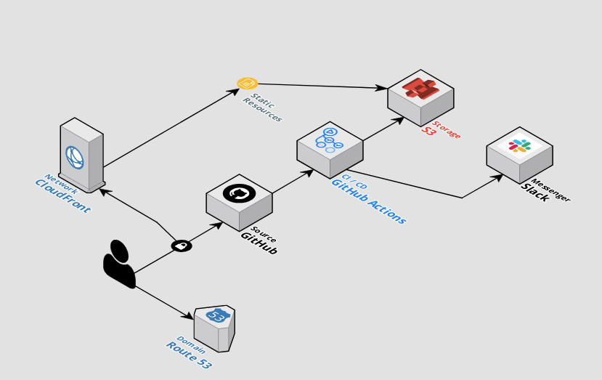
Automating Deployment
The previous slides showed manual steps to
Setup and configure.
“Deploy” the Angular application.
There are several ways to automate the process.
Automation using CLI scripts, Python scripts, ... ...
Higher layer frameworks, e.g. CloudFormation, Terraform, ... ...
GitHub actions.
... ...
https://github.com/byangular/angular-github-actions-s3-deploy
One of many tutorials and tools.

Slide 25
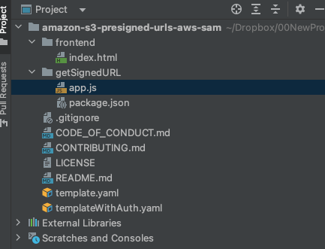
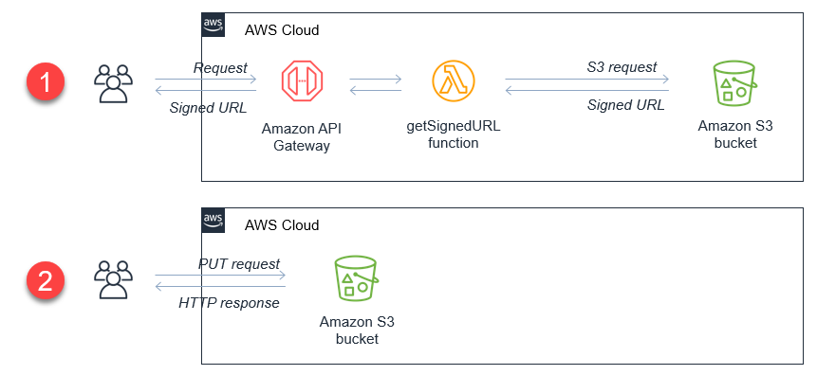
BLOB/Attachment Management
We have seen how to use S3:
Via an API from within a program.
For deploying and serving a web application and content, including images.
You can use the same technique for audio, video, etc. but most scenarios use a specialized streaming service on top of blob stores.
Microservices and web applications also use BLOB storage for upload/download of large items, e.g. files. RF Advisor used this approach on Azure.
https://aws.amazon.com/blogs/compute/uploading-to-amazon-s3-directly-from-a-web-or-mobile-application/
https://github.com/aws-samples/amazon-s3-presigned-urls-aws-sam

Slide 26
Microservices Continued
26 | E6156 – Topics in SW Engineering: Cloud Computing: Lecture 2 – Microservices, REST, Containers, PaaS, S3 © Donald F. Ferguson, 2021

Slide 27
Simple Flask Application – Configuration
Possible configurations:
There are three “things:” web server, application server, DB server.
A “thing” can be on your laptop or on AWS.
You want your code to be the same and get information from the configuration.
One simple approach is environment variables for web application.
The angular application can use the URL because. Why would the cloud deployed angular application access your local web application.
Show code for environment variables and how to set environment variables.
Locally in PyCharm
On EC2 (.bash_profile)
Show use of URL in Typescript.
These approaches are “OK” but there are more secure approaches.
Also, remember to set security group rules properly.

Slide 28
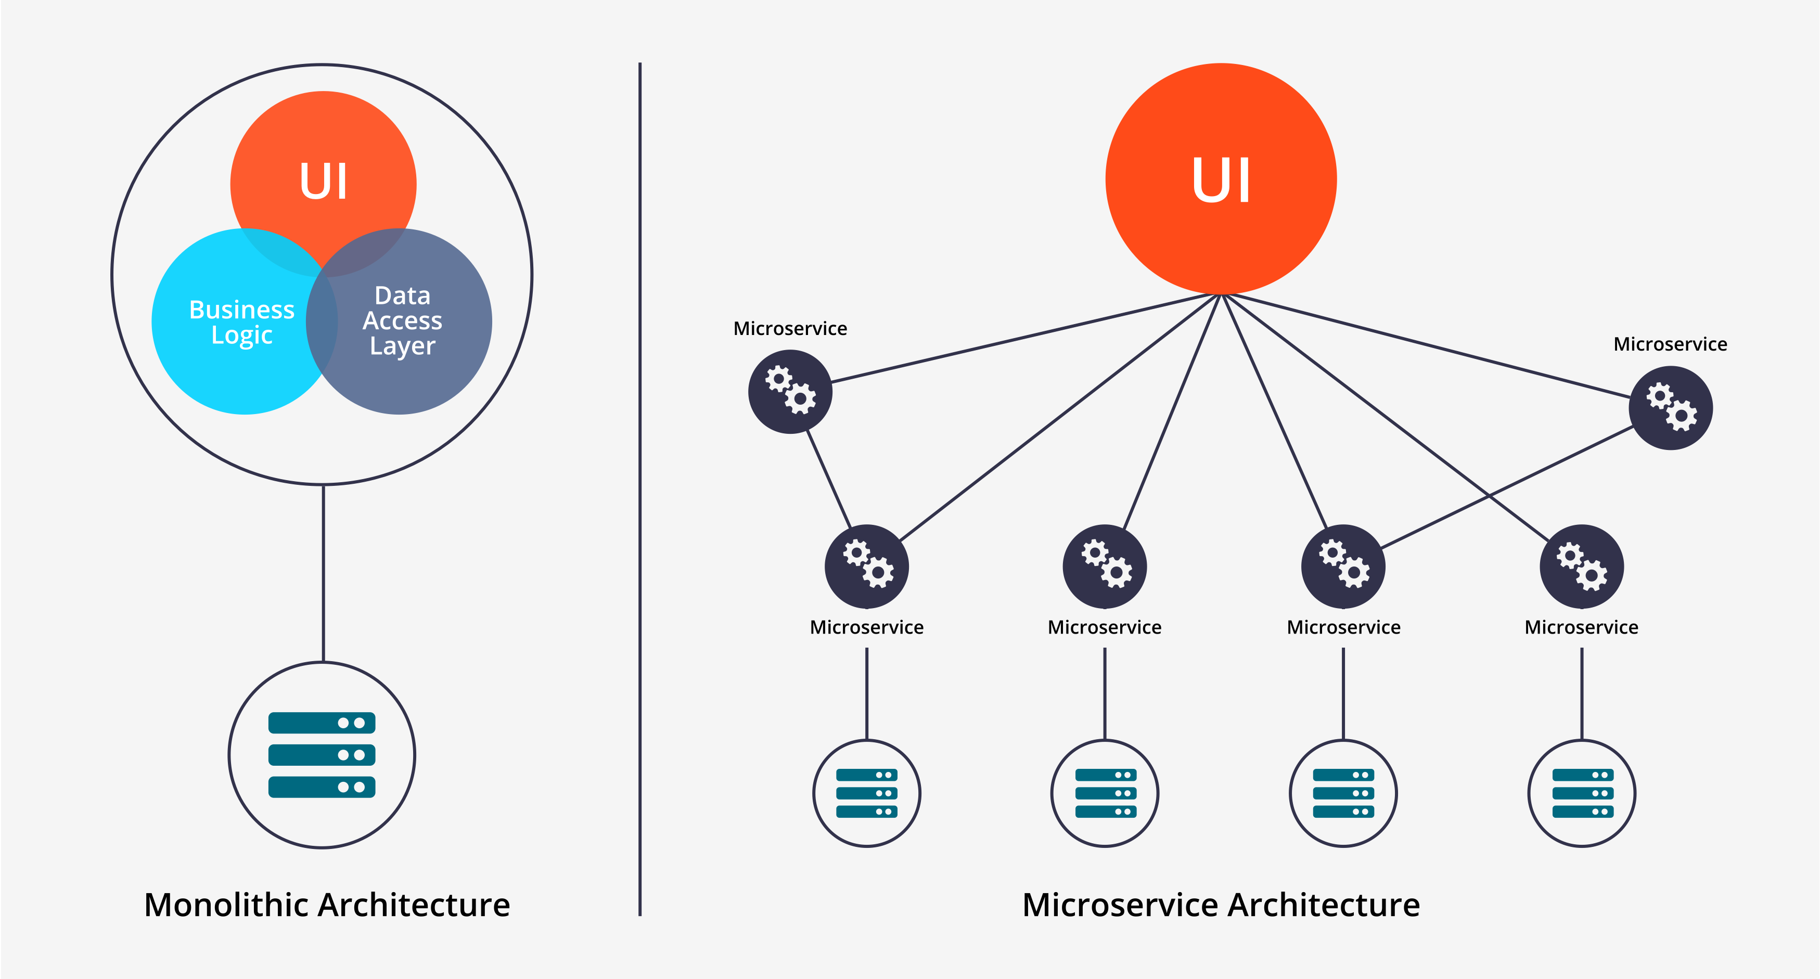
Microservices
Historically, complex applications were implemented and deployed as “one big application.”
Monolith Architecture is built in one large system and usually one code-base. A monolith is often deployed all at once, both front-end and back-end code together, regardless of what was changed.
Microservices Architecture is built as a suite of small services, each with their own code-base. These services are built around specific capabilities and are usually independently deployable.
Components of Microservices architecture:
The services are independent, small, and loosely coupled
Encapsulates a business or customer scenario
Every service is a different codebase
Services can be independently deployed
Services interact with each other using APIs
https://medium.com/hengky-sanjaya-blog/monolith-vs-microservices-b3953650dfd

Slide 29
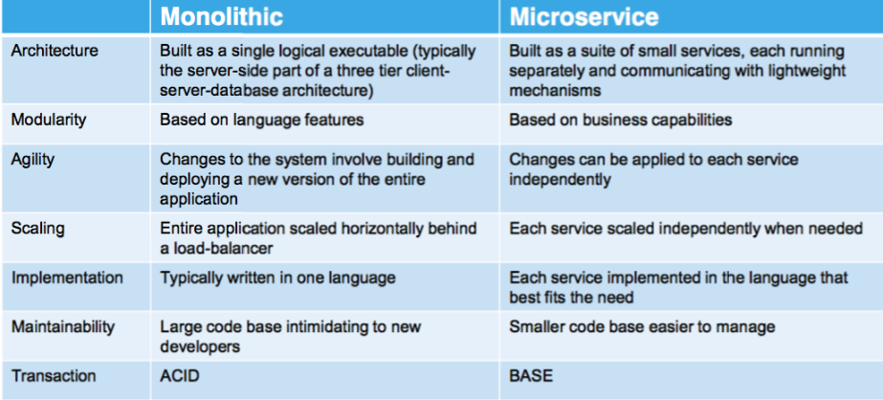
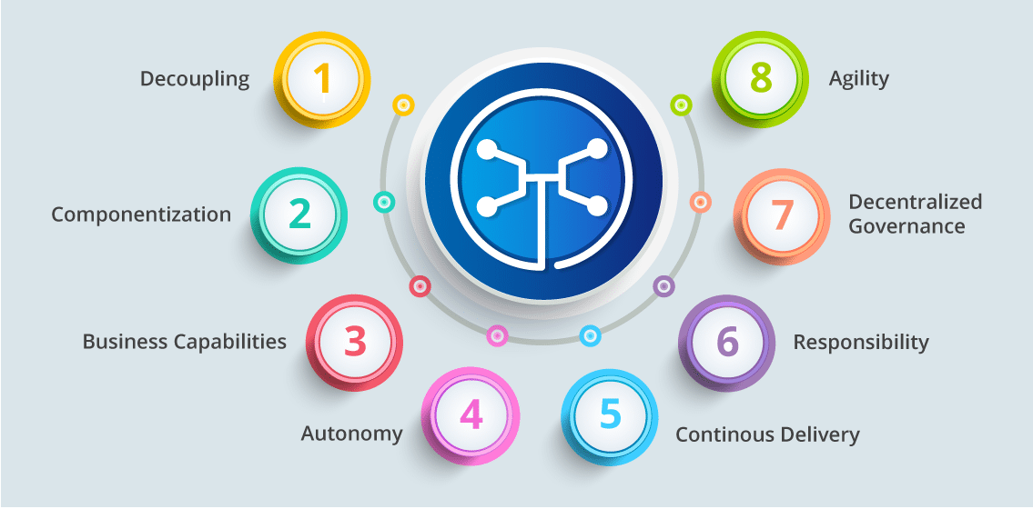
Microservices
You can drive yourself crazy trying to:
Compare microservice architectures to other architecture patterns.
Define the characteristics of microservices. What makes something a microservice?
Why do I cover microservices?
It does have benefits in large scale SW development projects.
It looks “cool” on your resume.

Slide 30
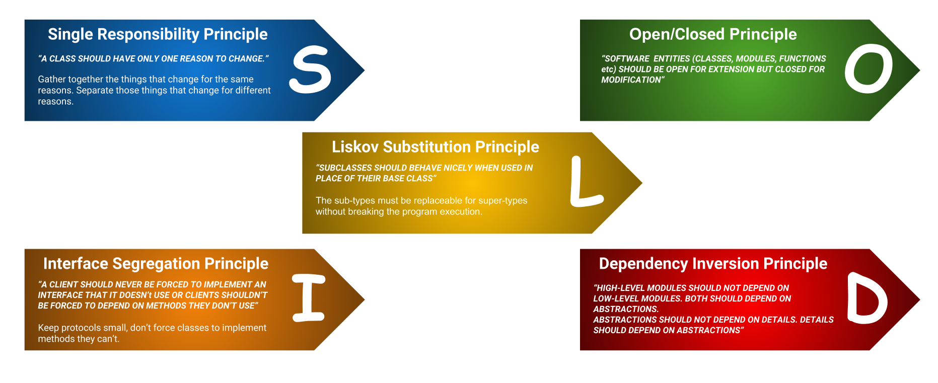
SOLID Principles
“In software engineering, SOLID is a mnemonic acronym for five design principles intended to make software designs more understandable, flexible, and maintainable. ” (https://en.wikipedia.org/wiki/SOLID)
The concept started with OO but applies to microservices.
We will focus on the “S” for now.
For our project purposes, a thing can be:
A user profile service
Or
A commerce catalog service
Or
...
But not both.

Slide 31
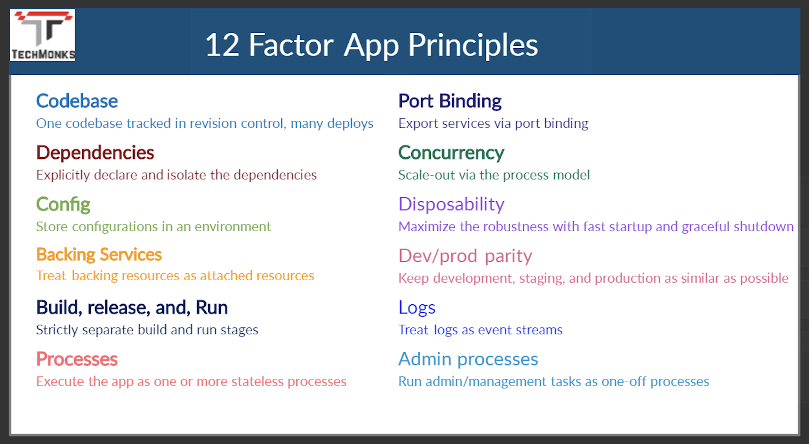
12 Factor Applications
https://dzone.com/articles/12-factor-app-principles-and-cloud-native-microser

Slide 32
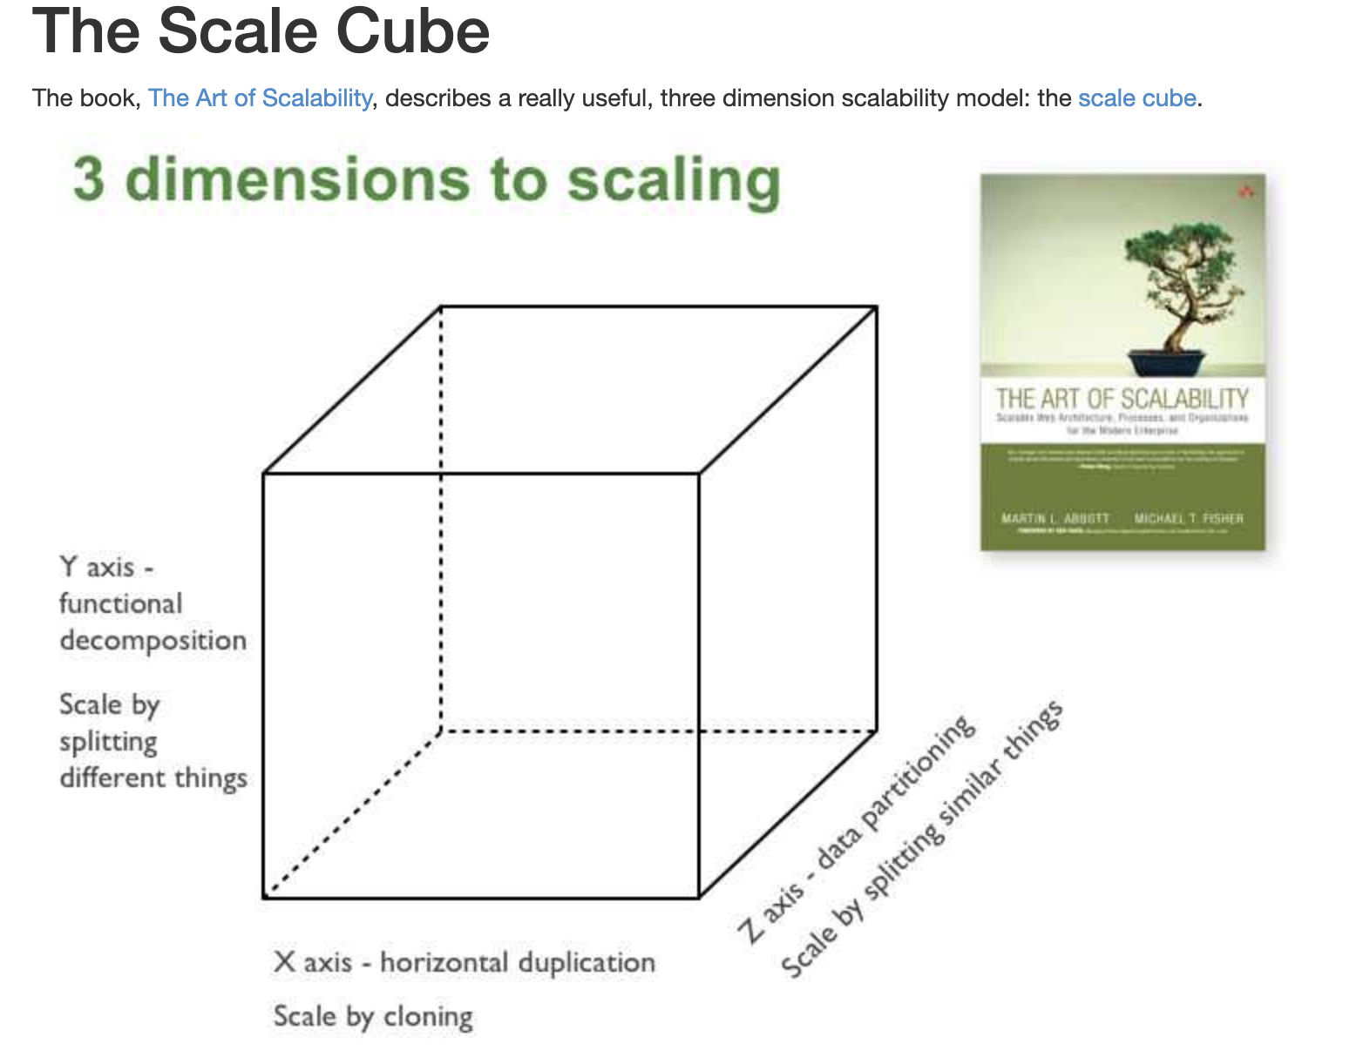
Microservices Scalability Cube
https://microservices.io/articles/scalecube.html
X-axis scaling consists of running multiple copies of an application behind a load balancer. If there are N copies then each copy handles 1/N of the load. This is a simple, commonly used approach of scaling an application.
Y-axis axis scaling splits the application into multiple, different services. Each service is responsible for one or more closely related functions.
When using Z-axis scaling each server runs an identical copy of the code. In this respect, it’s similar to X-axis scaling. The big difference is that each server is responsible for only a subset of the data. Some component of the system is responsible for routing each request to the appropriate server

Slide 33
XYZ – Scaling
There are three dimensions.
A complete solution/environment typical is a mix and composition of patterns.
Application design and data access determines opitions.

Slide 34
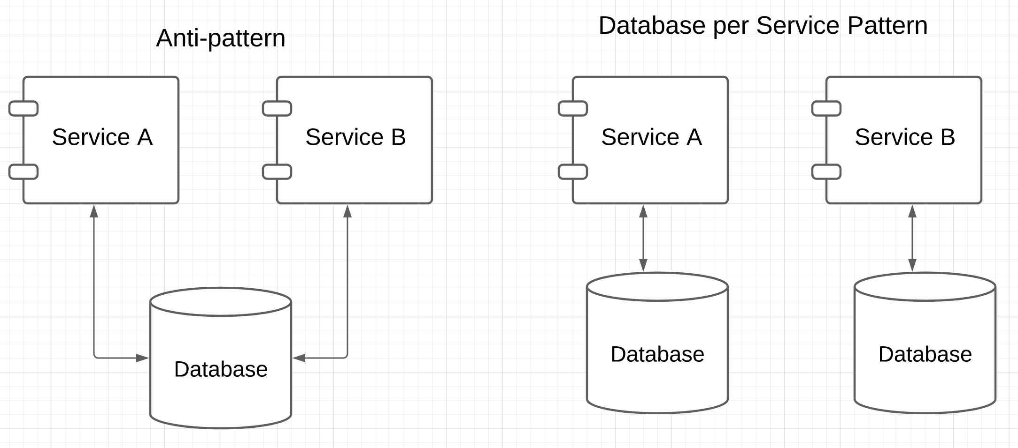

Patterns and Anti-patterns
“software design pattern is a general, reusable solution to a commonly occurring problem within a given context in software design. It is not a finished design that can be transformed directly into source or machine code. Rather, it is a description or template for how to solve a problem that can be used in many different situations.” (https://en.wikipedia.org/wiki/Software_design_pattern)
“An anti-pattern is a common response to a recurring problem that is usually ineffective and risks being highly counterproductive.” (https://en.wikipedia.org/wiki/Anti-pattern)
https://microservices.io/patterns/data/database-per-service.html
Prevents independent evolution by creating dependency.

Slide 35
Project Sprint 1
You are going to build 3 microservices. The exact ones you build will depend on the business/application problem you choose. My examples will be:
Customer registration and information. (Mandatory for all teams)
Catalog (Things I am selling)
Orders (Things people have bought and their status)
Databases:
Use RDS. You can use one RDS instance with 3 separate databases.
This approach is not good, but will simplify things for you.
You will deploy one of the services on each of:
EC2 – Directly on OS
Elastic Beanstalk
In a Docker container on an EC2 instance.
We will discuss more in
This lecture.

Slide 36
REST, Part I
36 | E6156 – Topics in SW Engineering: Cloud Computing: Lecture 2 – Microservices, REST, Containers, PaaS, S3 © Donald F. Ferguson, 2021

Slide 37

Concepts
37 | E6156 – Topics in SW Engineering: Cloud Computing: Lecture 2 – Microservices, REST, Containers, PaaS, S3 © Donald F. Ferguson, 2021

Slide 38
REST (https://restfulapi.net/)
What is REST
REST is acronym for REpresentational State Transfer. It is architectural style for distributed hypermedia systems and was first presented by Roy Fielding in 2000 in his famous dissertation.
Like any other architectural style, REST also does have it’s own 6 guiding constraints which must be satisfied if an interface needs to be referred as RESTful. These principles are listed below.
Guiding Principles of REST
Client–server – By separating the user interface concerns from the data storage concerns, we improve the portability of the user interface across multiple platforms and improve scalability by simplifying the server components.
Stateless – Each request from client to server must contain all of the information necessary to understand the request, and cannot take advantage of any stored context on the server. Session state is therefore kept entirely on the client.
Cacheable – Cache constraints require that the data within a response to a request be implicitly or explicitly labeled as cacheable or non-cacheable. If a response is cacheable, then a client cache is given the right to reuse that response data for later, equivalent requests.
Uniform interface – By applying the software engineering principle of generality to the component interface, the overall system architecture is simplified and the visibility of interactions is improved. In order to obtain a uniform interface, multiple architectural constraints are needed to guide the behavior of components. REST is defined by four interface constraints: identification of resources; manipulation of resources through representations; self-descriptive messages; and, hypermedia as the engine of application state.
Layered system – The layered system style allows an architecture to be composed of hierarchical layers by constraining component behavior such that each component cannot “see” beyond the immediate layer with which they are interacting.
Code on demand (optional) – REST allows client functionality to be extended by downloading and executing code in the form of applets or scripts. This simplifies clients by reducing the number of features required to be pre-implemented.

Slide 39
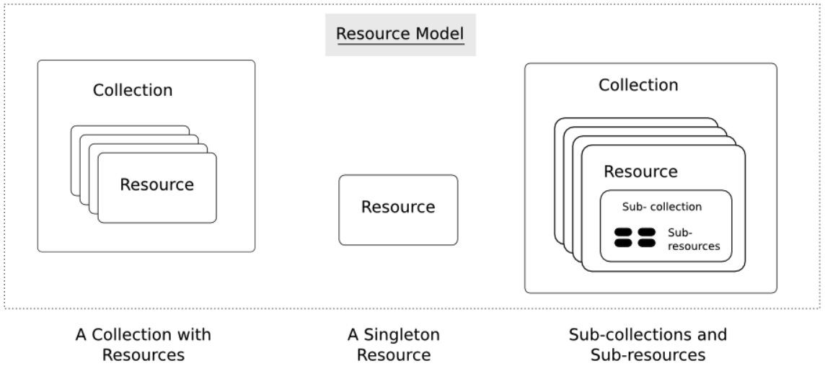
Resources
Resources are an abstraction. The application maps to create things and actions.
“A resource-oriented API is generally modeled as a resource hierarchy, where each node is either a simple resource or a collection resource. For convenience, they are often called a resource and a collection, respectively.
A collection contains a list of resources of the same type. For example, a user has a collection of contacts.
A resource has some state and zero or more sub-resources. Each sub-resource can be either a simple resource or a collection resource.
For example, Gmail API has a collection of users, each user has a collection of messages, a collection of threads, a collection of labels, a profile resource, and several setting resources.
While there is some conceptual alignment between storage systems and REST APIs, a service with a resource-oriented API is not necessarily a database, and has enormous flexibility in how it interprets resources and methods. For example, creating a calendar event (resource) may create additional events for attendees, send email invitations to attendees, reserve conference rooms, and update video conference schedules. (Emphasis added) (https://cloud.google.com/apis/design/resources#resources)
https://restful-api-design.readthedocs.io/en/latest/resources.html

Slide 40
REST – Resource Oriented
When writing applications, we are used to writing functions or methods:
openAccount(last_name, first_name, tax_payer_id)
account.deposit(deposit_amount)
account.close()
We can create and implement whatever functions we need.
REST only allows four methods:
POST: Create a resource
GET: Retrieve a resource
PUT: Update a resource
DELETE: Delete a resource
That’s it. That’s all you get.
A REST client needs no prior knowledge about how to interact with any particular application or server beyond a generic understanding of hypermedia.
“The key characteristic of a resource-oriented API is that it emphasizes resources (data model) over the methods performed on the resources (functionality). A typical resource-oriented API exposes a large number of resources with a small number of methods.” (https://cloud.google.com/apis/design/resources)

Slide 41
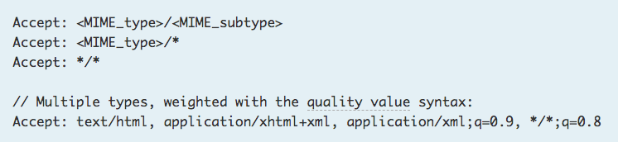
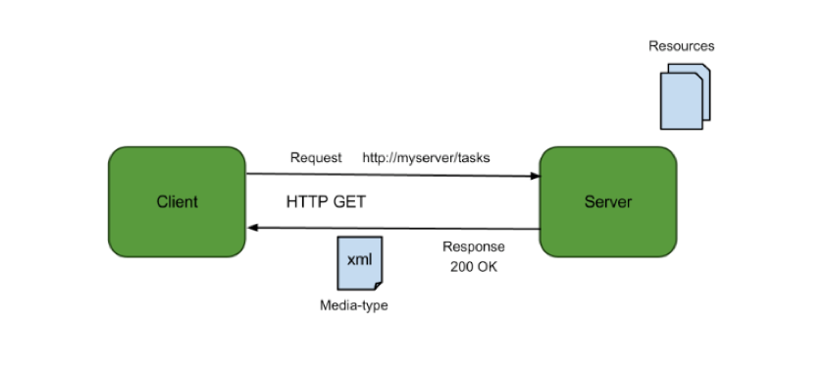
Resources, URLs, Content Types
Relative URL identifies “resource” on the server.
Server implementation maps abstract resource to tangible “thing,” file, DB row, … and any application logic.
Accept type in headers.
Client may be
Browser
Mobile device
Other REST Service
… …
Web media (content) type, e.g.
text/html
application/json

Slide 42
REST Principles
What about all of those principles?
Client/Server
Stateless
Cacheable
Uniform Interface
Layered System
Code on demand
Some of these principles
Are simple and obvious.
Are subtle and have major implications.
Stateless can be baffling, but we will cover later.
We will go into the principles in later lectures, ... but first linked resources ... ...

Slide 43
Linked Data
43 | E6156 – Topics in SW Engineering: Cloud Computing: Lecture 2 – Microservices, REST, Containers, PaaS, S3 © Donald F. Ferguson, 2021

Slide 44
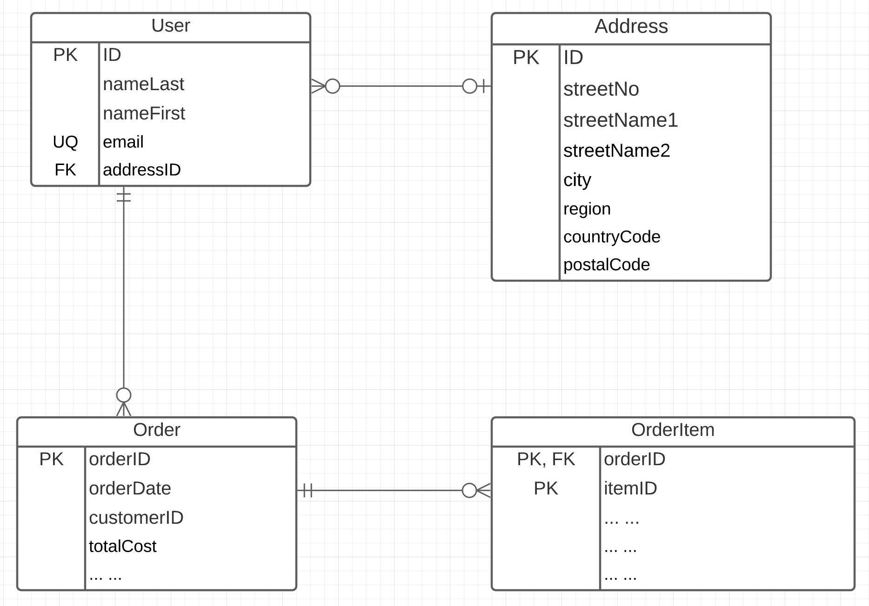
Linked Data
Consider two microservices:
UserService handles two resources:
User
Address
OrderService handles two resources:
Order
OrderItem
Associations/Link/Relationships can be surprisingly complicated. There are many considerations. (See https://www.uml-diagrams.org/association.html)
In this example, we have
Association (User-Address, User-Order)
Composition (Order-OrderItem)

Slide 45
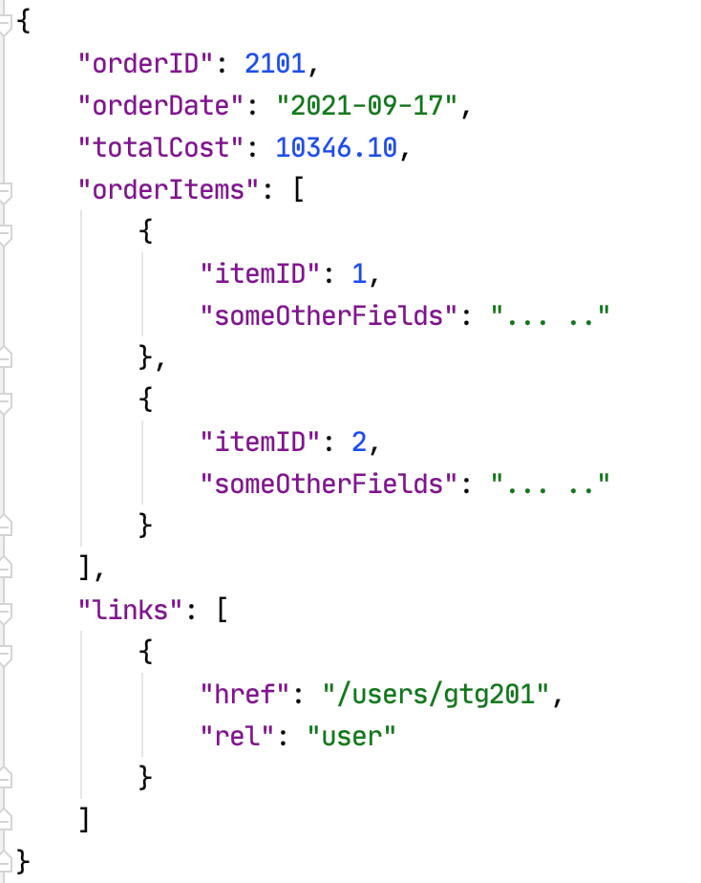
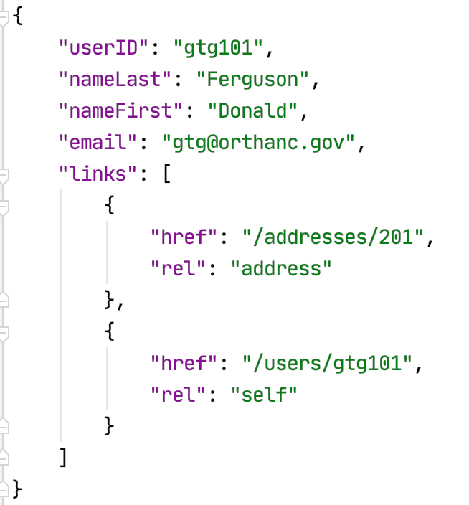
Resource Paths
The simple object model might/could/would/should have the following:
/users
/users/<userID>
/users/<userID>/address
/users/<userID>/orders
/addresses
/addresses/<addressID>/users
/orders/<orderID>
/orders/<orderID>/orderitems
/orders<orderID>/orderitems/<itemID>
... ...
How do you “point backwards” in a “foreign key relationship,” e.g. Address → User
“href” : “/users?addressID=201”
This means you store the addressID in the DB but return a link om REST.
Composition
Association

Slide 46
Introduction to PaaS Elastic Beanstalk
46 | E6156 – Topics in SW Engineering: Cloud Computing: Lecture 2 – Microservices, REST, Containers, PaaS, S3 © Donald F. Ferguson, 2021

Slide 47
Platform-as-a-Service
” Platform as a service (PaaS) is an enabler for software development where a third-party service provider delivers a platform to customers so they can develop, run, and manage software applications without the need to build and maintain the underlying infrastructure themselves.” (https://www.infoworld.com/article/3223434/what-is-paas-a-simpler-way-to-build-software-applications.html)
“Platform as a service (PaaS) is a complete development and deployment environment in the cloud, with resources that enable you to deliver everything from simple cloud-based apps to sophisticated, cloud-enabled enterprise applications. ... ... PaaS allows you to avoid the expense and complexity of buying and managing software licenses, the underlying application infrastructure and middleware, container orchestrators such as Kubernetes, or the development tools and other resources. You manage the applications and services you develop, and the cloud service provider typically manages everything else. (https://azure.microsoft.com/en-us/overview/what-is-paas/)

Slide 48
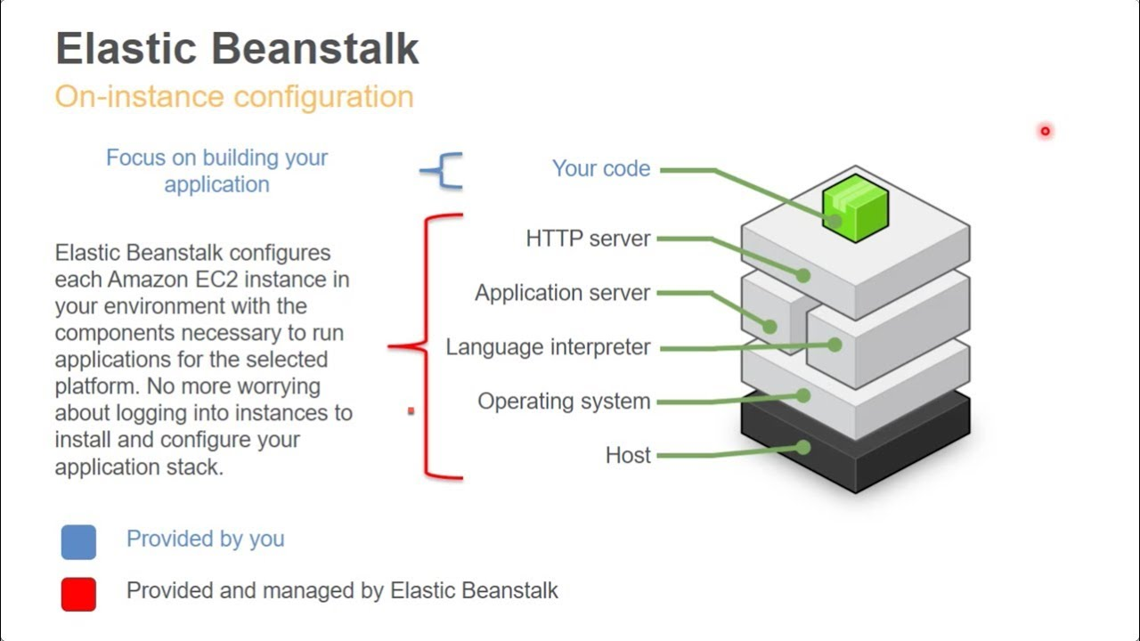
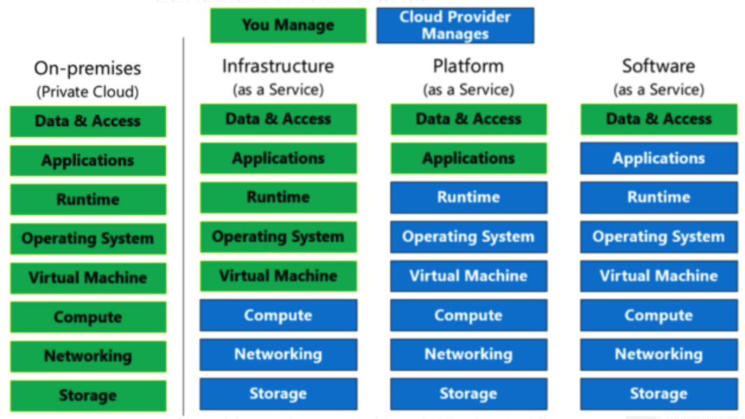
Platform-as-a-Service
Simplistically, PaaS adds two additional layers on top of IaaS:
Runtime means the language environment, libraries, etc. your application needs. For example, in our case this will mean a predefined and configured Flask environment.
“Middleware is a type of computer software that provides services to software applications beyond those available from the operating system.” (https://en.wikipedia.org/wiki/Middleware)
Basically, you do not have to build an application execution environment by installing libraries, services, ... You application “goes into a premade environment.”
Less flexible and customizable than IaaS but can be more productive to use for application scenarios.

Slide 49
Clarifying PaaS
This is a little hard to understand until you have done it a few times.
IaaS basically stops at the operating system layer. You are responsible for everything else your application code needs:
Database
Logging Service
... ...
PaaS provides a prebuilt environment with “your code goes here.”
The easiest way to see the difference is
You are using EC2 (or will be).
We will use a PaaS (Elastic Beanstalk) And you will get a feel for the differences.
So, let’s do this.

Slide 50
Start with Elastic Beanstalk
There are several reasonably good tutorials on using EB and Flask
https://docs.aws.amazon.com/elasticbeanstalk/latest/dg/create-deploy-python-flask.html
https://medium.com/analytics-vidhya/deploying-a-flask-app-to-aws-elastic-beanstalk-f320033fda3c
AWS and technology evolve. So, sometimes you have to tinker with them.
The first time you deploy, it can be error prone. But after you succeed, modifying or deploying new applications is “rinse and repeat.”
I normally just:
Create an environment with the sample application.
Download the sample and un-compress.
Modify the application to add functions.
Upload a new version.
There are a couple of issues:
Make start with a new environment and add just the packages you need.
If you add packages, you must use pip freeze > requirements.txt.
Zip acts weird, especially on Mac.
Do not zip the folder. Go inside the folder and zip just the contents you need.
On Mac: zip -r -X Archive.zip *
Note: Walk through EB console and development process.
Show sample from my GitHub repo.

Slide 51
Elastic Beanstalk
Set up environment.
Add some code.
Reupload.
Explain how this works in the long term.

Slide 52
API First Design
52 | E6156 – Topics in SW Engineering: Cloud Computing: Lecture 2 – Microservices, REST, Containers, PaaS, S3 © Donald F. Ferguson, 2021

Slide 53
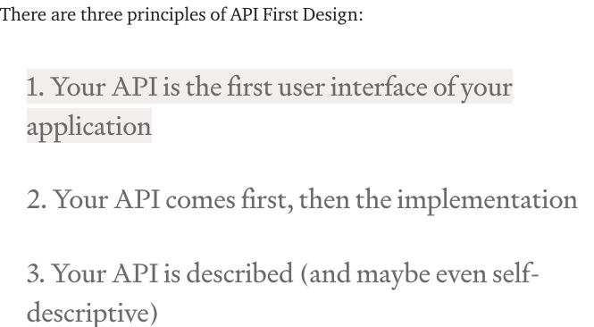
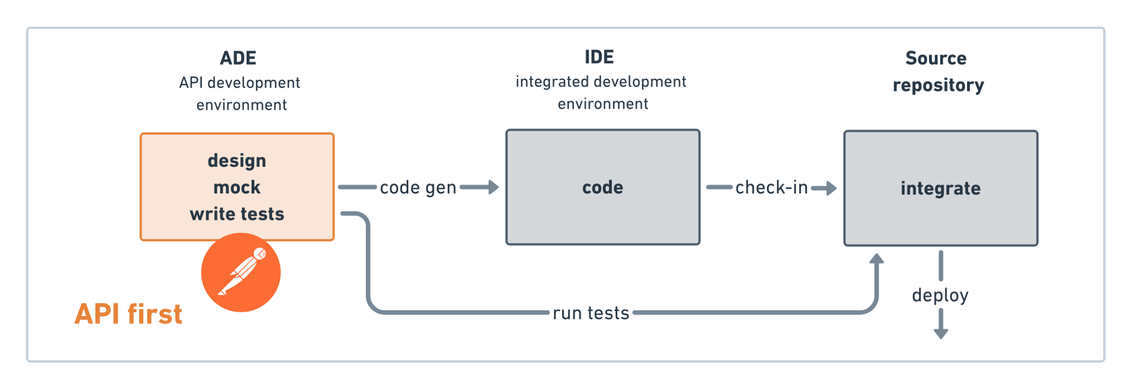
API First Design
There used to be two approaches to application development:
Data First: Define your datamodel and then implement functions/APIs.
UX First: Define and mockup the UI. Test with users. Implement functions.
Cloud Native Microservices often follow API First.
Define APIs.
Implement mockups, simple tests, etc.
Get feedback from potential users and partners.
Deploy and document,
(https://medium.com/adobetech/three-principles-of-api-first-design-fa6666d9f694)
(https://medium.com/better-practices/api-first-software-development-for-modern-organizations-fdbfba9a66d3)

Slide 54
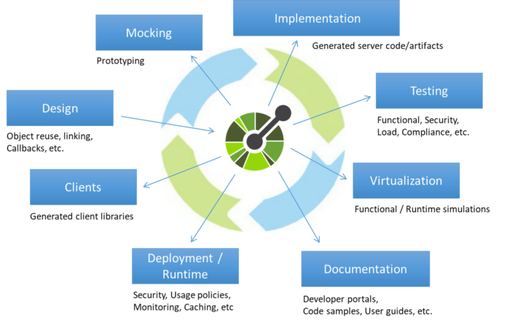
Open API
“The OpenAPI Initiative (OAI) was created by a consortium of forward-looking industry experts who recognize the immense value of standardizing on how APIs are described. As an open governance structure under the Linux Foundation, the OAI is focused on creating, evolving and promoting a vendor neutral description format.” (https://www.openapis.org/about)
There is an interactive “map” that explains the API concepts (http://openapi-map.apihandyman.io/)
I (sometimes) use:
SwaggerHub
Swagger Code Generation
To produce implementation templates from specifications.
Demo the project. (https://github.com/donald-f-ferguson/f21-demo-swagger)
Show SwaggerHub.

Slide 55
Demo Open API (Swagger Hub)
There are two approaches to defining APIs:
Build Open API definition → Code generation tools.
Start with source code and add “annotations,” e.g. https://flask-rest-api.readthedocs.io/en/stable/openapi.html
Simple example ... ... https://app.swaggerhub.com/apis/donff2/F21User/1.0.0
Demo f21-demo-swagger
http://localhost:8080/donff2/F21User/1.0.0/ui/

Slide 56
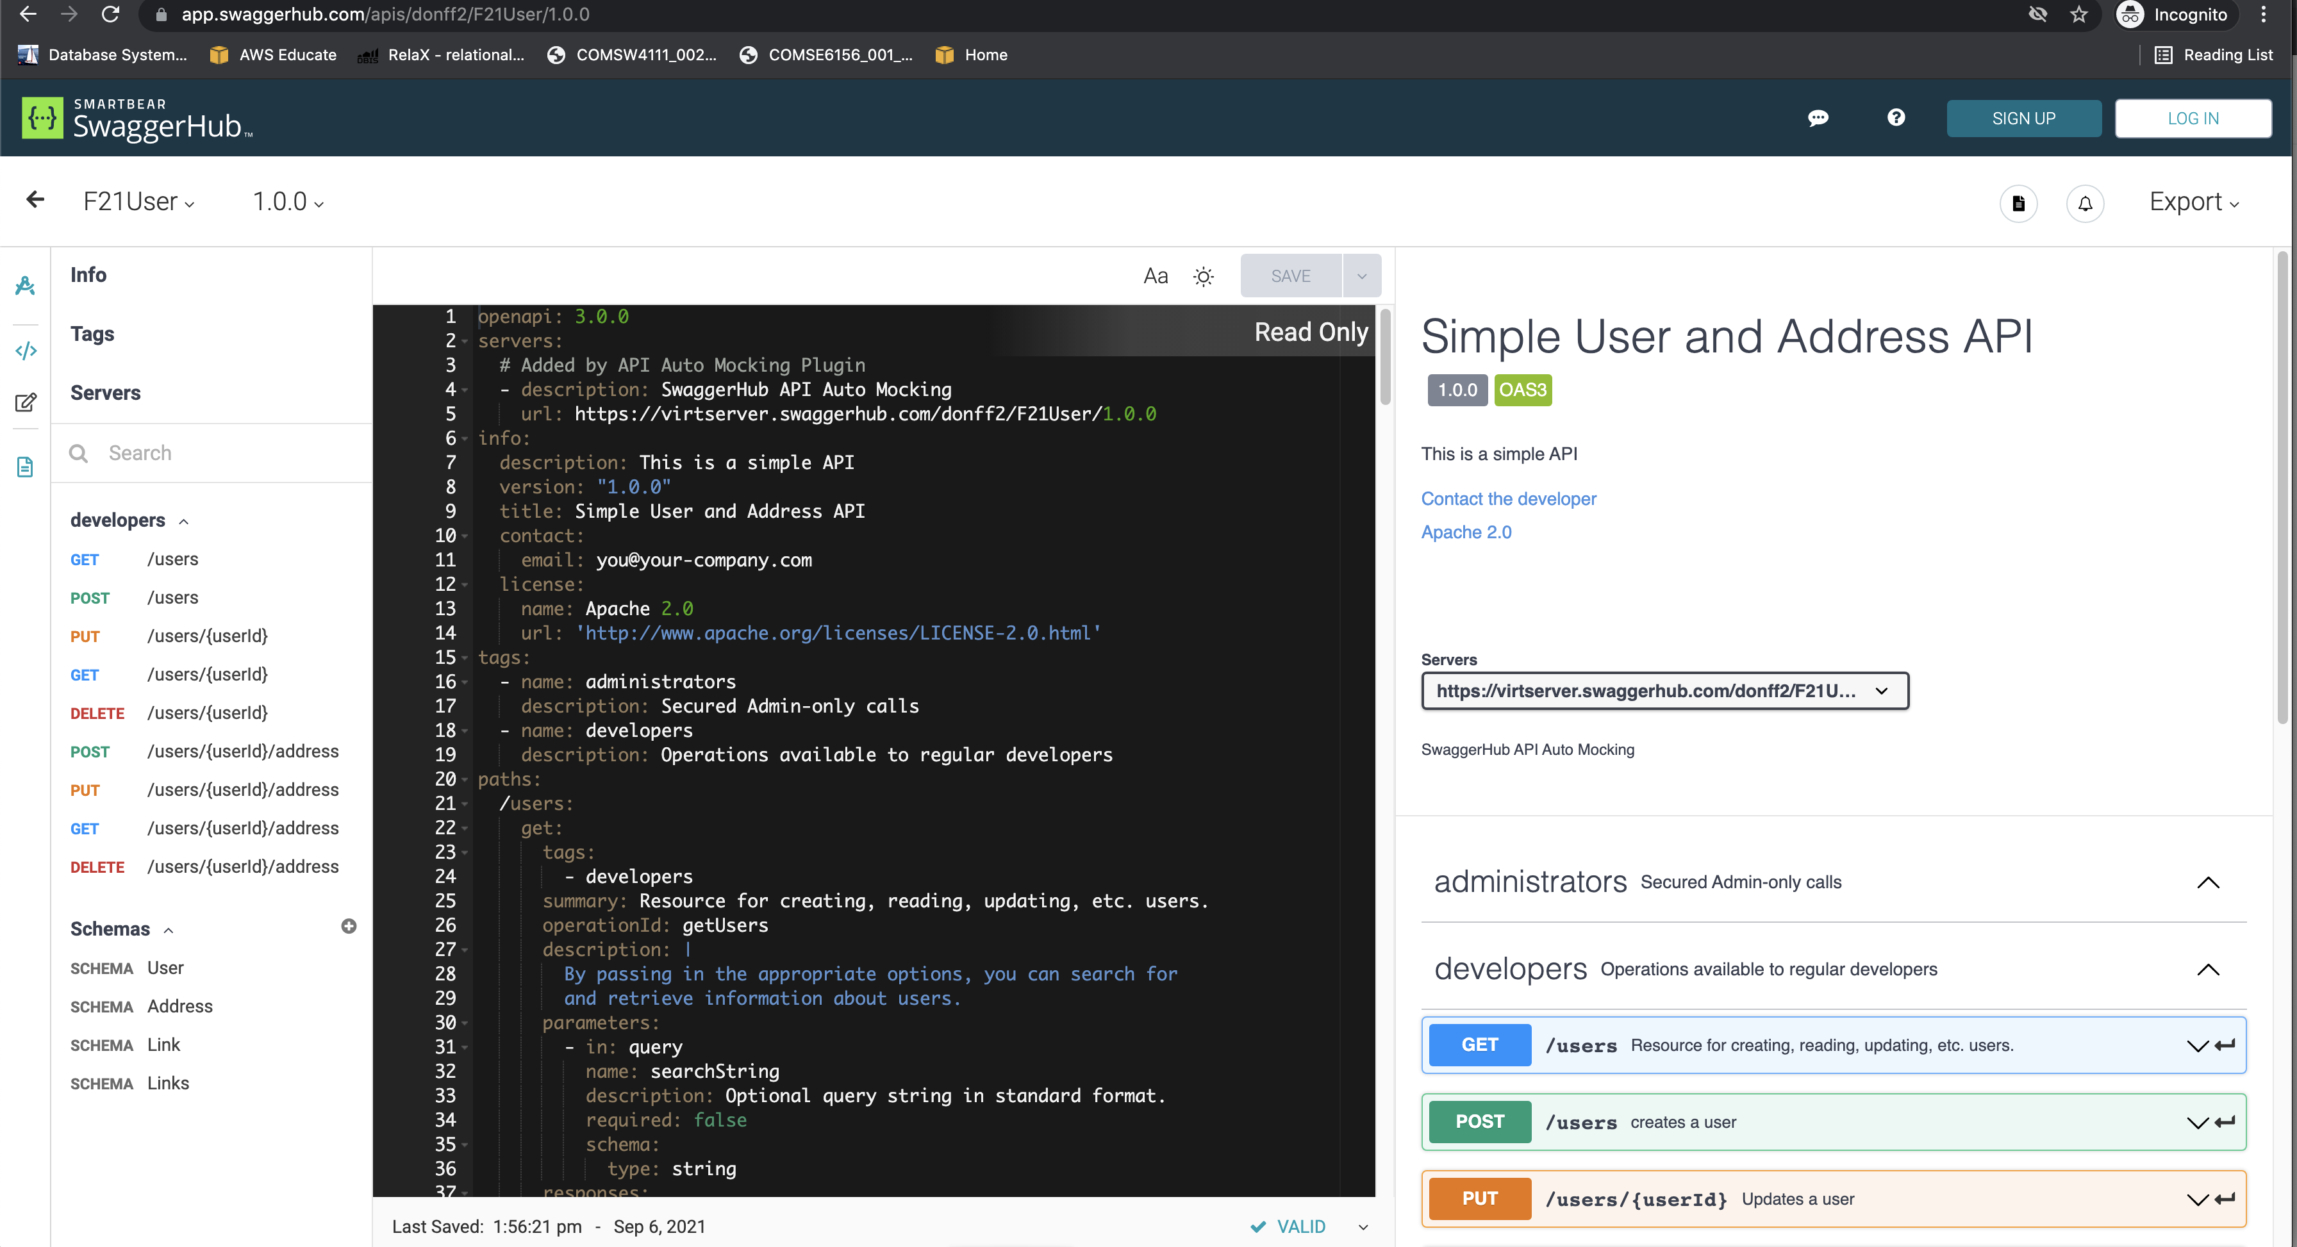
Example

Slide 57
Containers
57 | E6156 – Topics in SW Engineering: Cloud Computing: Lecture 2 – Microservices, REST, Containers, PaaS, S3 © Donald F. Ferguson, 2021

Slide 58
Fundamental, Recurring Problem
I have one big computer and I want to run multiple applications.
This creates several challenges, e.g.
Resource sharing and allocation (CPU, memory, disk, ... ...)
Isolation: Application A should not be able to corrupt/mess with application B’s files, memory, ... ...
Configuration: Applications require libraries, versions of libraries, prerequisites, compiler/interpreter levels, ... ...
Basically, I want a way to someone package or fence all of this. We see some of the issues with Java Classpath, Python environments, ...
There are a few ways to do this:
OS process and paths.
VMs
Containers

Slide 59
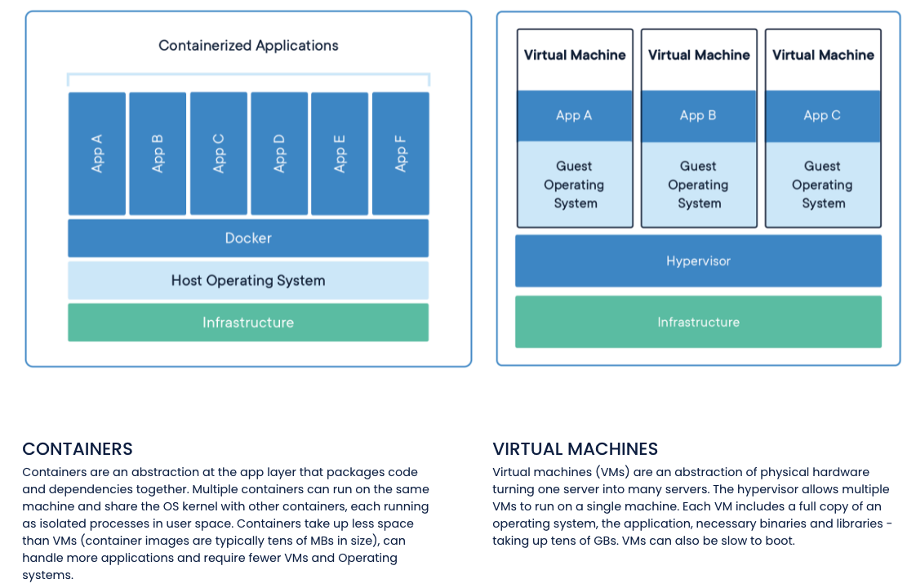
Containers and VMs

Slide 60
Concept (from Wikipedia)
“cgroups (abbreviated from control groups) is a Linux kernel feature that limits, accounts for, and isolates the resource usage (CPU, memory, disk I/O, network, etc.) of a collection of processes.”
“Namespaces are a feature of the Linux kernel that partitions kernel resources such that one set of processes sees one set of resources while another set of processes sees a different set of resources. ... ... those namespaces refer to distinct resources. Resources may exist in multiple spaces. Examples of such resources are process IDs, hostnames, user IDs, file names, and some names associated with network access, ...”

Slide 61
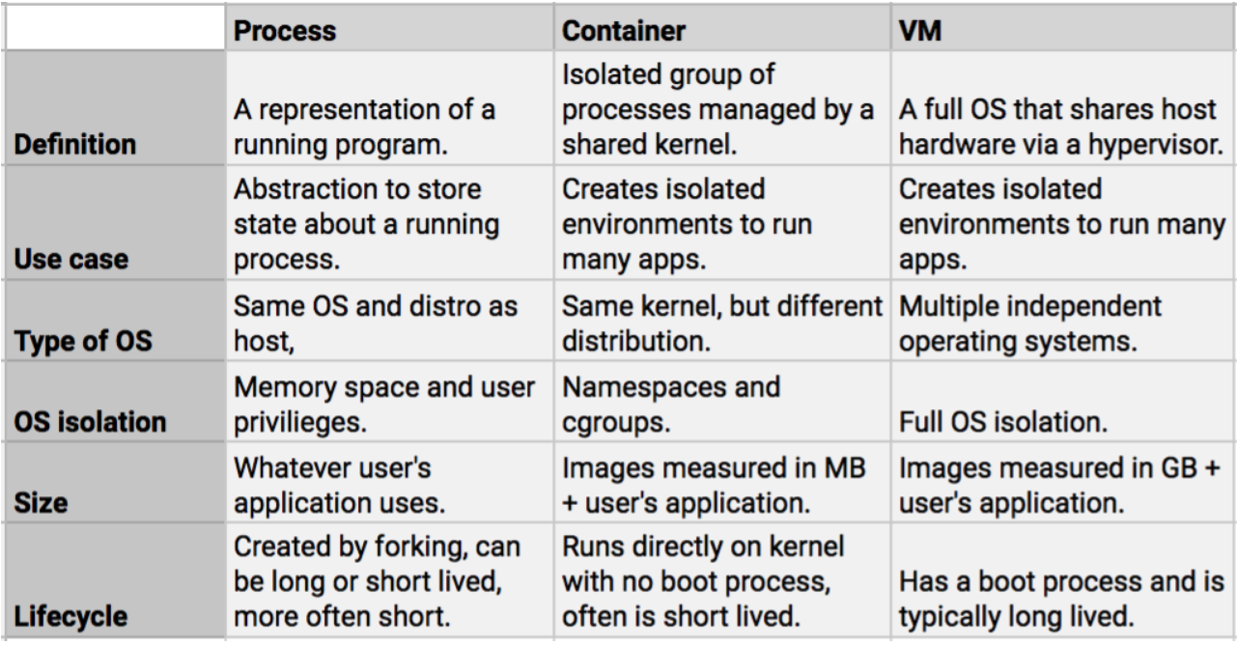
Containers vs VMs

Slide 62
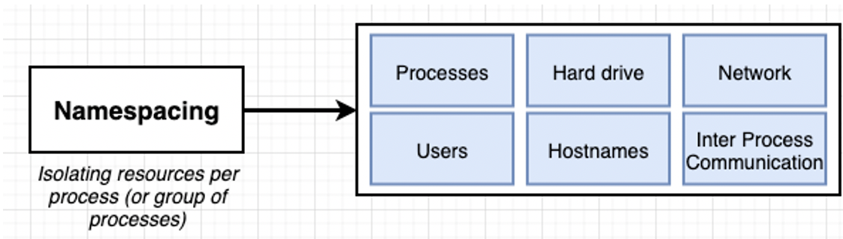
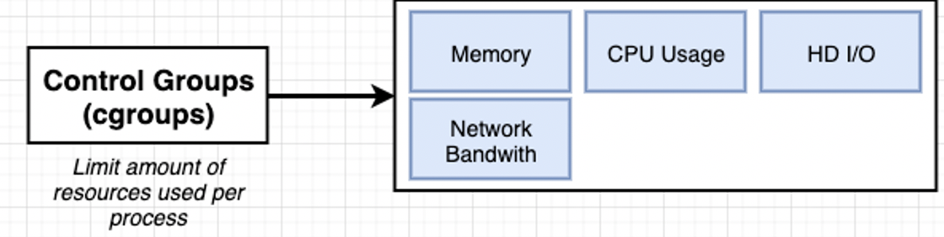
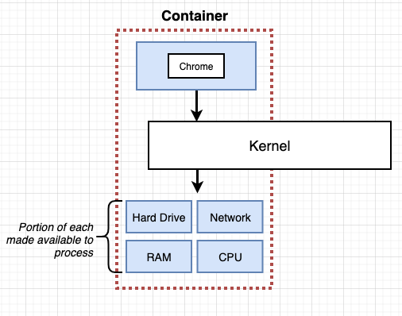
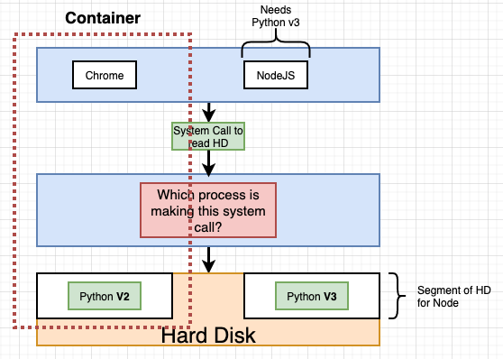
Some Container/Docker Implementation Concepts
Isolates libraries, paths, packages, PIDs, ... ...
Partitions and caps resource consumption.

Slide 63
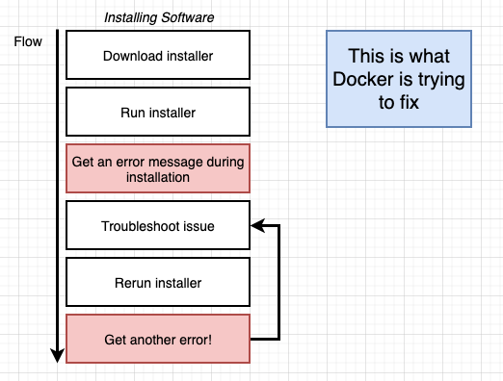
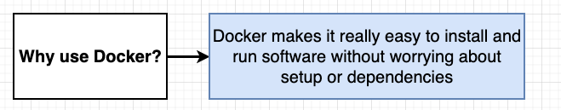
Containers and Some Docker Overview
We are familiar with the problem
We have a system with an OS and installed SW.
We need to install something new, and that requires installing prerequisites, changing versions, etc.
After many tries, we get the application installed only to find out we broke some other application.
Docker and containers allow you to:
Develop an application or SW system.
Package up the entire environment (paths, versions, libs, ...) into an image that works and is self-contained.
Someone installing/starting your application simply gets the image from a repository and starts the image to create a running container.

Slide 64
Simple Tutorial
We will follow this tutorial https://docs.docker.com/language/python/ to get experience.
But, the in the future, basic idea is the same as we have previously followed.
The steps:
Find an example of something cool.
Download it, set it up and run it.
Modify it and add my application code and logic.
Push it somewhere, in this case Docker Hub
Deploy on the cloud. AWS gives you two or three options:
Docker on EC2
Elastic Container Service
I also used this: https://www.docker.com/blog/containerized-python-development-part-2/

Slide 65
Overview
Cloned the repository.
Files
Run container

Slide 66
Project – Sprint 1 (Note: Show Trello, Agile, etc).
66 | E6156 – Topics in SW Engineering: Cloud Computing: Lecture 2 – Microservices, REST, Containers, PaaS, S3 © Donald F. Ferguson, 2021

Slide 67
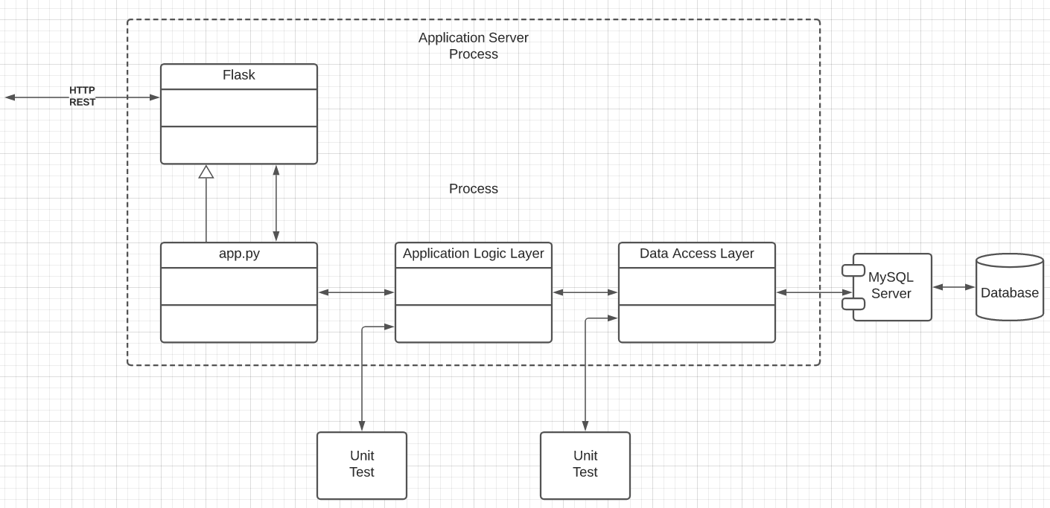
Specification (TBD)
Build microservices:
Users, ... ...
Deploy users on Use two separate RDS instances.
Implement a layered architecture:
Data objects for access DBs.
Application logic in app services.
Routing in app.py
Implement paths:
/users
/users/{id}
/users/{id}address
/addresses
/addresses/{addressId}
/addresses/{addressId}/users
... ...
Do a very simple UI and deploy on S3.

Slide 68
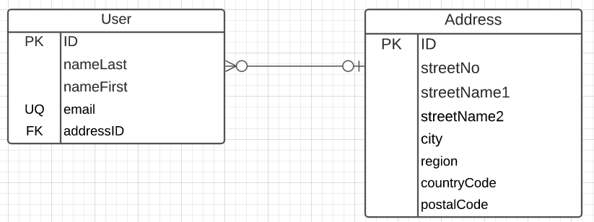
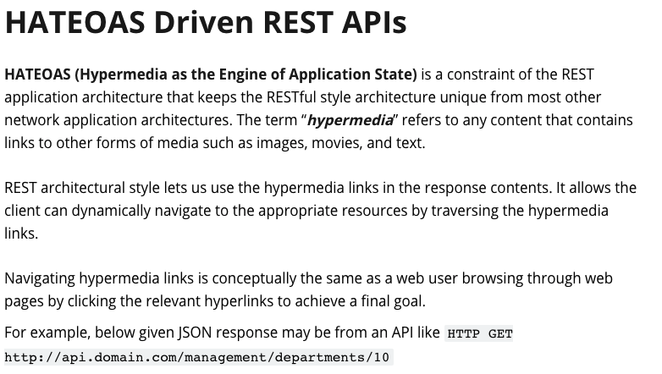
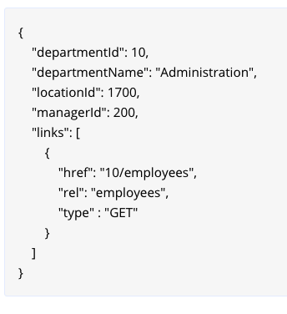
Implement Linked Data
A user has 0 or 1 addresses.
Several people make have the same address.
IDs must be unique and service generated.
Country code must come from a valid list of country codes.
City cannot contain numbers.
Email must have valid format:
Contain “@”
End in one of:
.edu
.com
.org
.mil
Only the following may be NULL
nameFirst
streetName2
https://restfulapi.net/hateoas/

